Slide 1
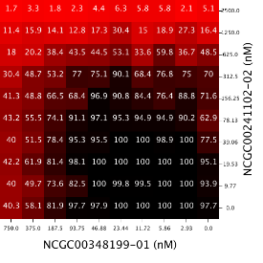
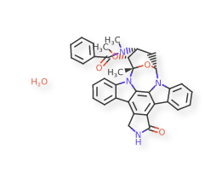
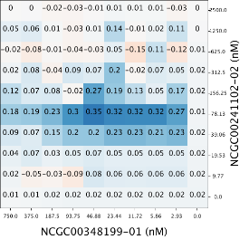
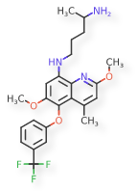
Similar Compounds Show Similar Activities- Is This True for Drug Combinations?
Intern: Sarita Lee
Mentors: Raj Guha & Lu Chen

Slide 2
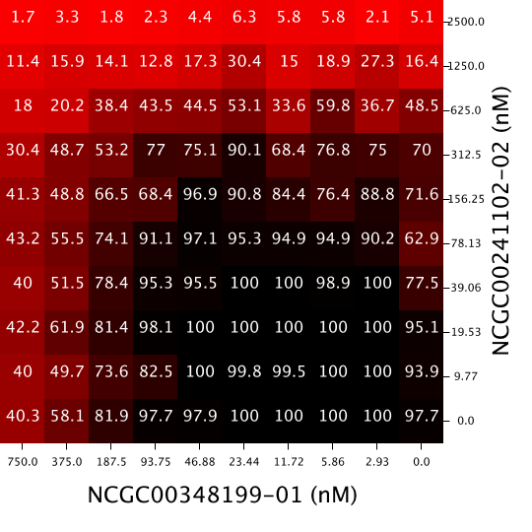
Introduction- Drug Combinations and Synergy
Response Matrix
Drug combinations are used to treat many medical conditions such as: HIV, malaria, and cancer
Sometimes the combined effect of drugs is different than their individual effects
When it is better: synergism
When it is the same: additive
When it is worse: antagonism
Drug Y
Drug X

Slide 3
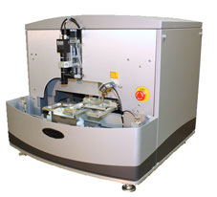
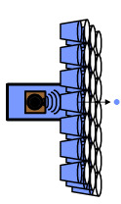
Introduction- Screening Drug Combinations
Run single agent dose responses
Traditionally, screening for drug combinations has been a slow process
Since NCATS has high throughput screening (HTS), data for thousands of drug combinations can be generated quickly
Presents opportunity to do large scale analysis
6x6 matrices for
potential synergies
Acoustic dispense,
15 min for 1260 wells, 14 min for 1200 wells
10x10 for confirmation + self-cross

Slide 4
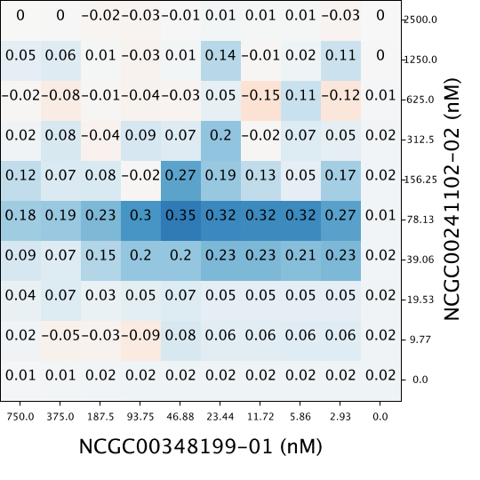
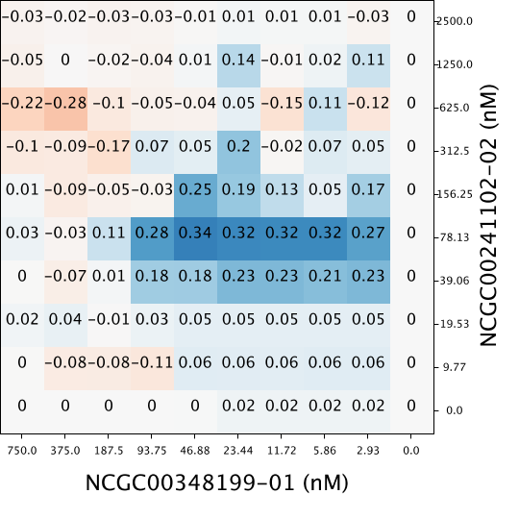
Introduction- Methods to Measure Synergy
Synergy is quantified with respect to a model of additivity
Three Models:
Highest Single Agent (HSA)
Bliss Independence Model
Loewe Additivity Model
Used Bliss Independence Model: convenient and more robust in high throughput setting
Response Matrix
Synergy Matrix-
HSA
Synergy Matrix-
Δ Bliss
Nikolaus J. Sucher (2014). Searching for synergy in silico, in vitro and in vivo. Synergy, 1(1), 30-43.

Slide 5
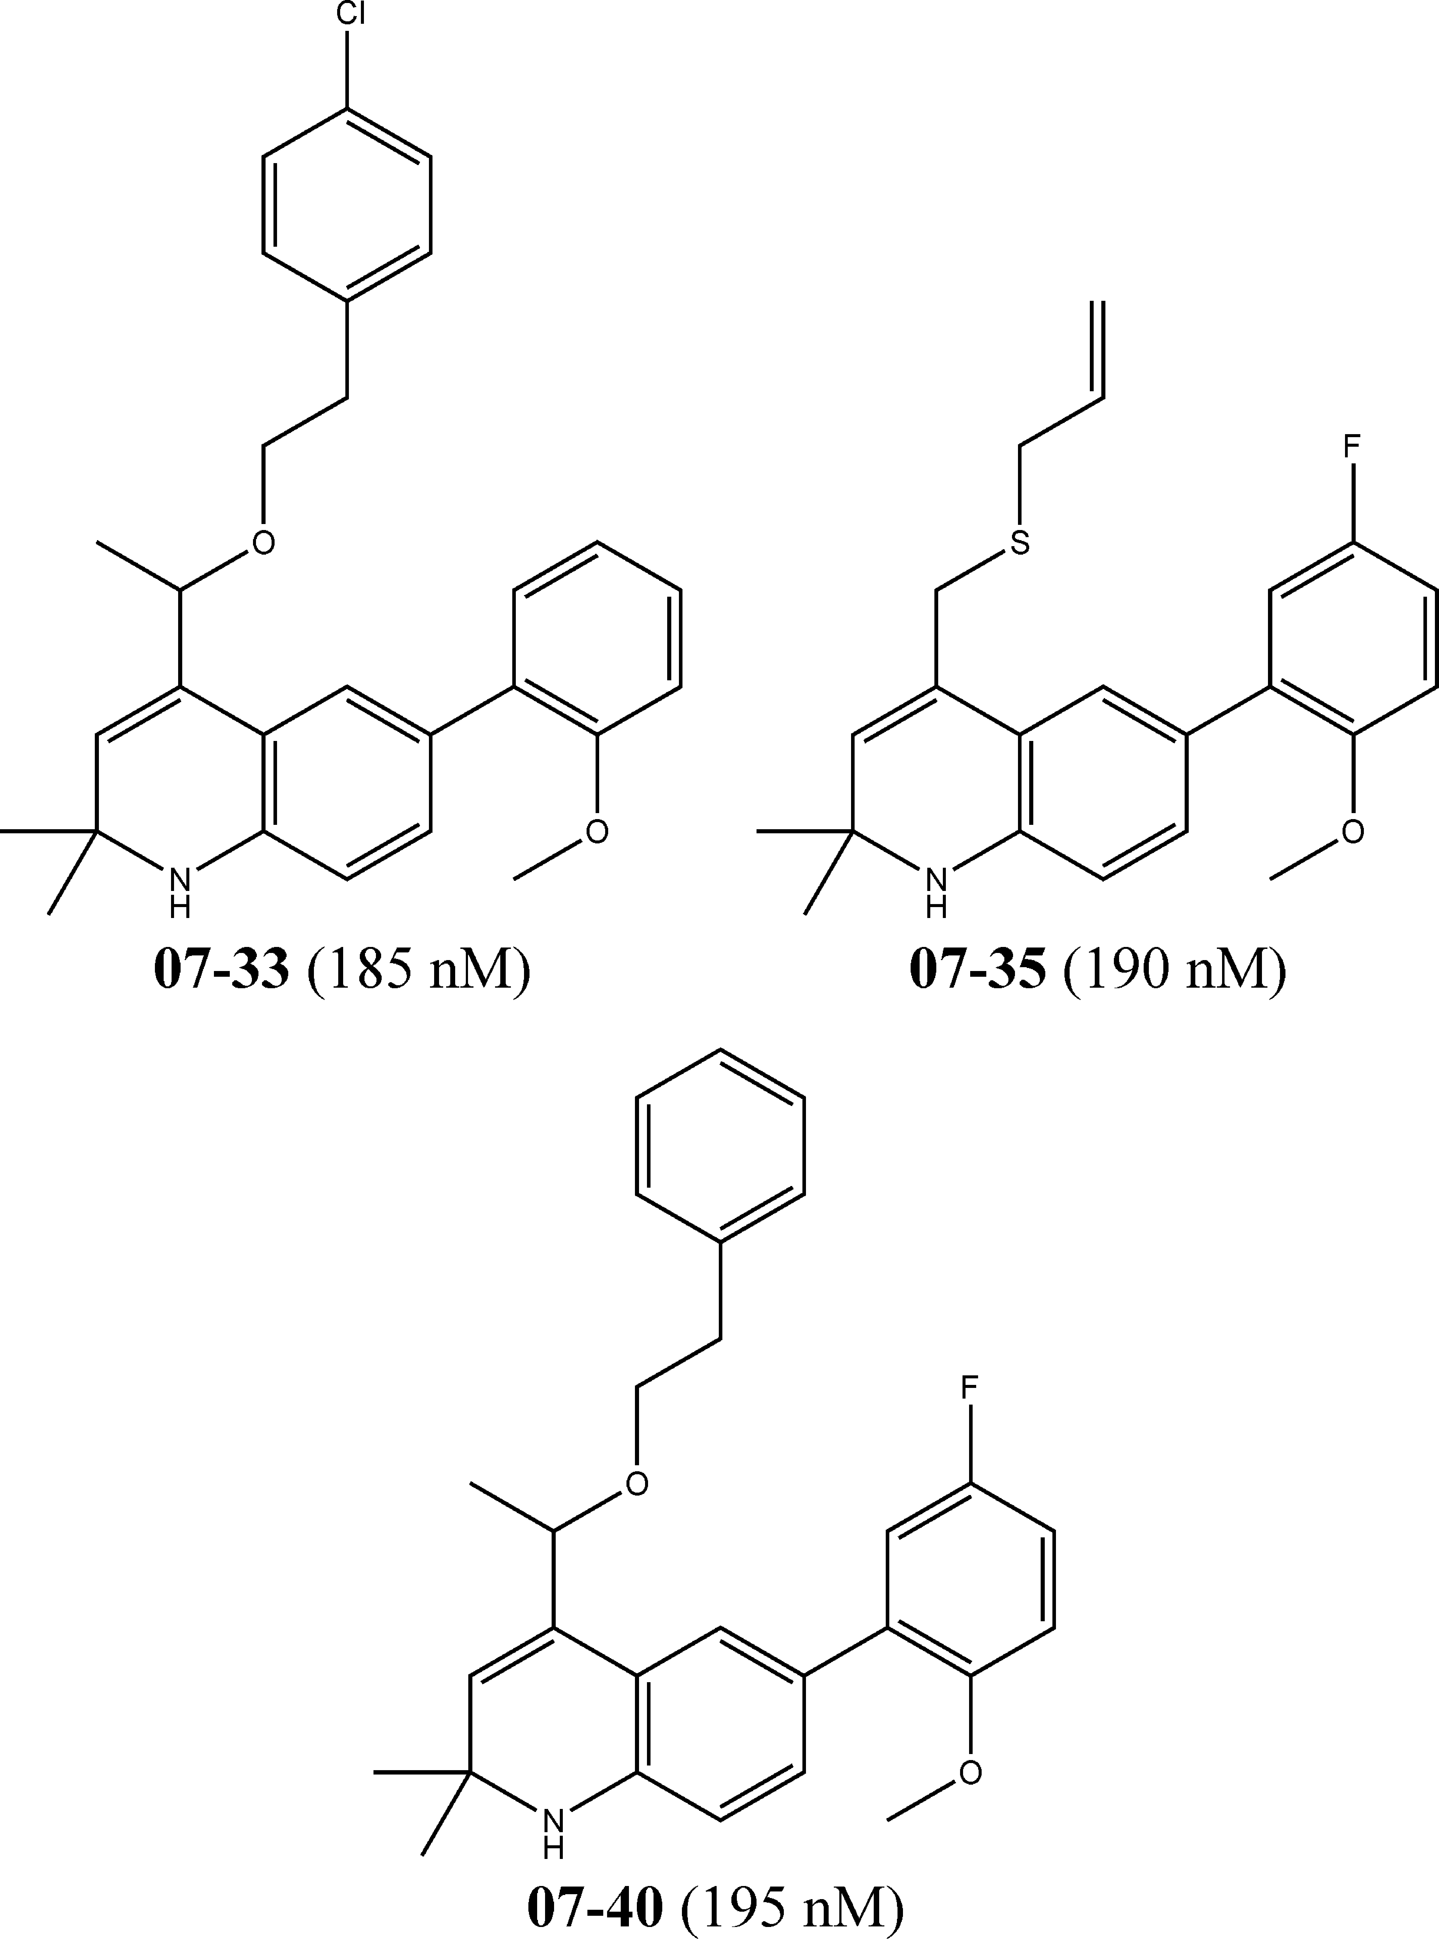
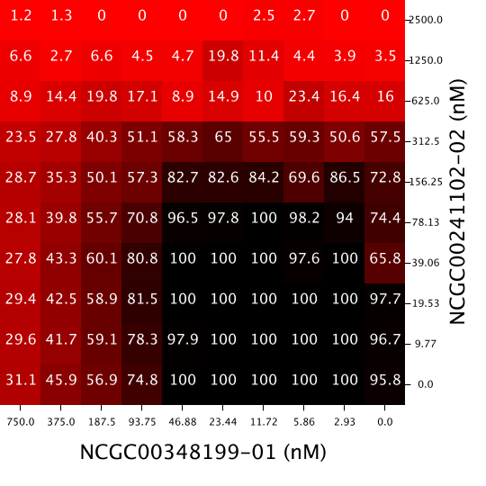
Introduction- Similarity Property Principle
Similar Compounds- tend to show similar activities
Dissimilar Compounds-
tend to show dissimilar activities
Similarity Property Principle: “Similar compounds have similar properties”
Will the similarity property principle hold for drug combinations?
Do similar drug combinations have similar properties?
Yvonne C. Martin, James L. Kofron, Linda M. Traphagen (2002). Do Structurally Similar Molecules Have Similar Biological Activity? Journal of Medicinal Chemistry, 45 (19), 4350-4358.
Rajarshi Guha, John H. Van Drie (2008). Structure-Activity Landscape Index: Identifying and Quantifying Activity Cliffs. Journal of Chemical Informatics and Modeling, 48(3), 646-658.

Slide 6
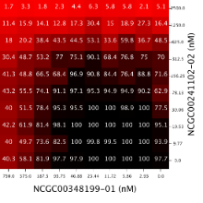
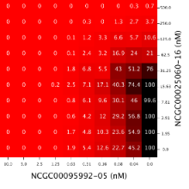
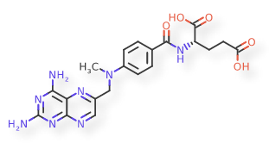
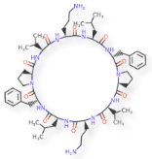
Overarching Questions
Question 1: What are metrics to quantify dissimilarity between two response matrices or synergy matrices?
Question 2: Does chemical structure correlate to combination response? Synergy? How?
Question 3: Does dose response correlate to combination response? Synergy? How?
Drug Combo A:
Response Matrix
Drug Combo B:
Response Matrix
Drug Combo A:
Compounds
Drug Combo B:
Compounds
Drug Combo A:
Dose Response
Drug Combo B:
Dose Response

Slide 7
Overarching Questions
Question 1: What are metrics to quantify dissimilarity between two response matrices or synergy matrices?
Question 2: Does chemical structure correlate to combination response? Synergy? How?
Question 3: Does dose response correlate to combination response? Synergy? How?
Drug Combo A:
Response Matrix
Drug Combo B:
Response Matrix
Drug Combo A:
Compounds
Drug Combo B:
Compounds
Drug Combo A:
Dose Response
Drug Combo B:
Dose Response

Slide 8
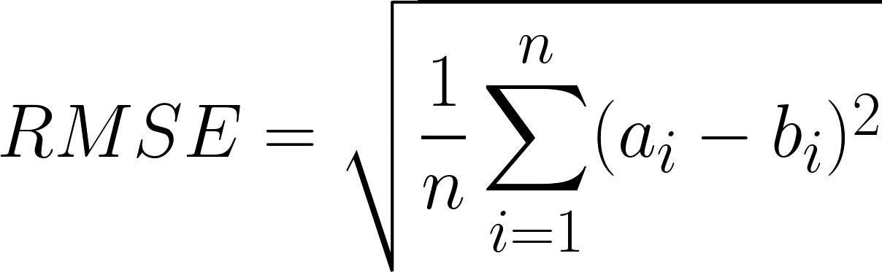
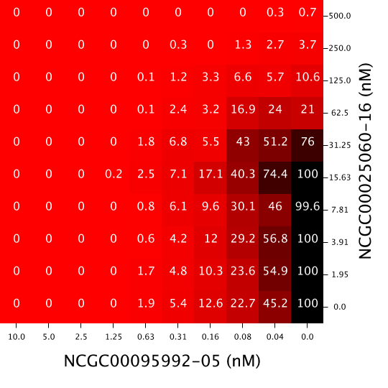
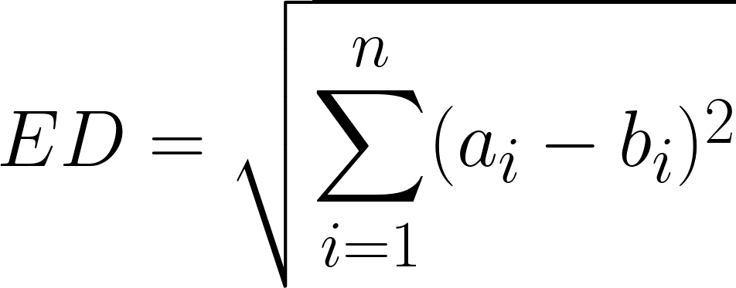
Question 1: Dissimilarity Metrics
Insensitive to Spatial Distribution
Sensitive to Spatial Distribution
1. Root Mean Standard Error (RMSE)
2. Euclidean Distance (ED)
3. Two- Sample Kolmogorov-Smirnov Test (KS Test)
4. Syrjala Test
Drug Combo A
Drug Combo B
Using these four metrics, dissimilarity was computed for all pairs of drug combinations
Stephen E. Syrjala, (1996). A Statistical Test for a Difference between the Spatial Distributions of Two Populations. Ecology, 77(1), 75-80.

Slide 9
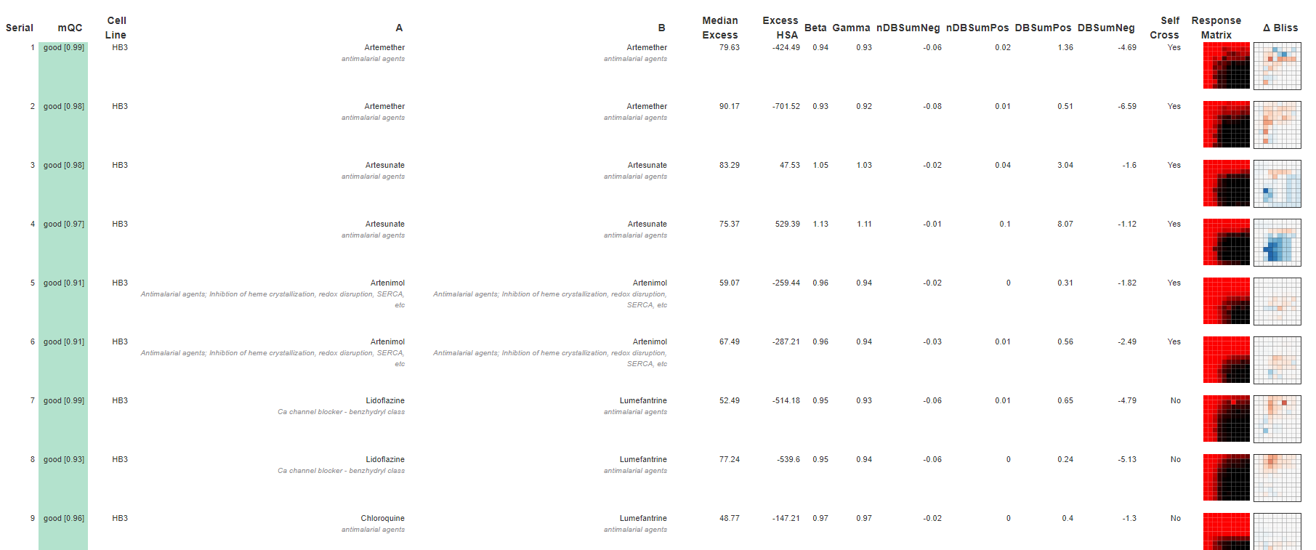
Question 1: Dissimilarity Metrics- Malaria AID 1764 (cell line HB3)
(First 9 drug combinations displayed; 480 total in the assay)

Slide 10
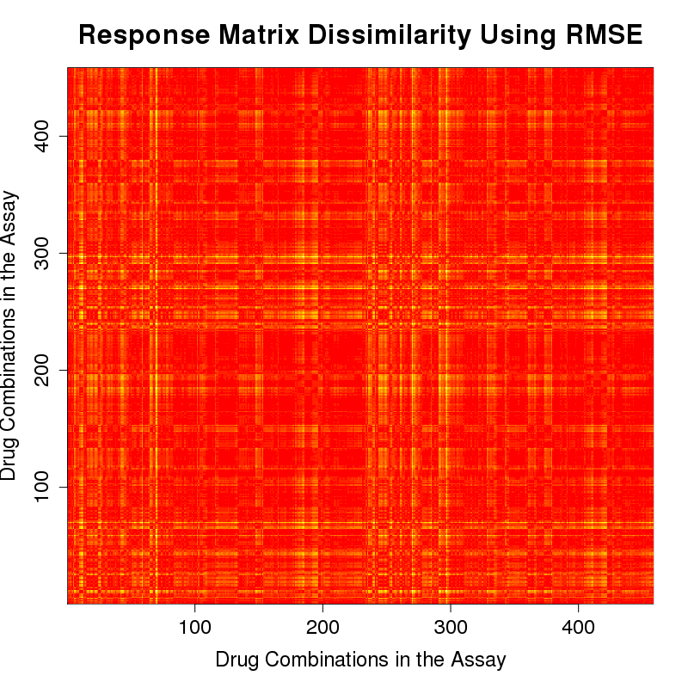
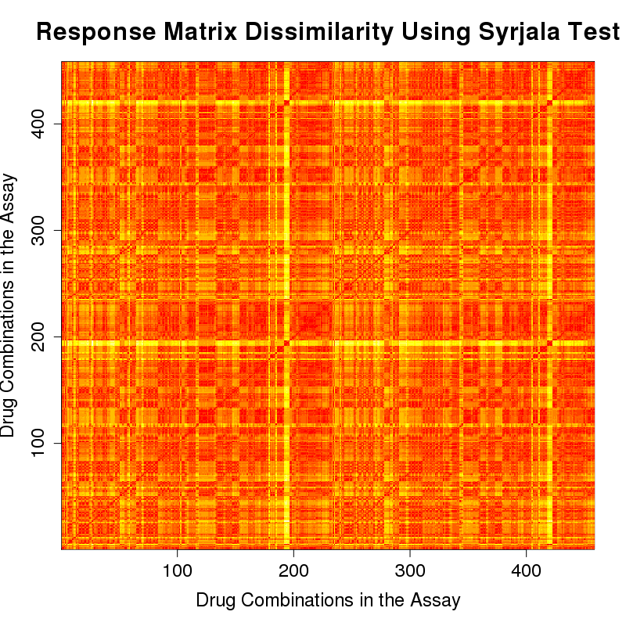
Question 1: Dissimilarity Metrics- Response Matrices Malaria Strain HB3 (AID 1764)
Red: dissimilarity=0, more similar
Yellow: dissimilarity=1,
more dissimilar
RMSE
Syrjala Test

Slide 11
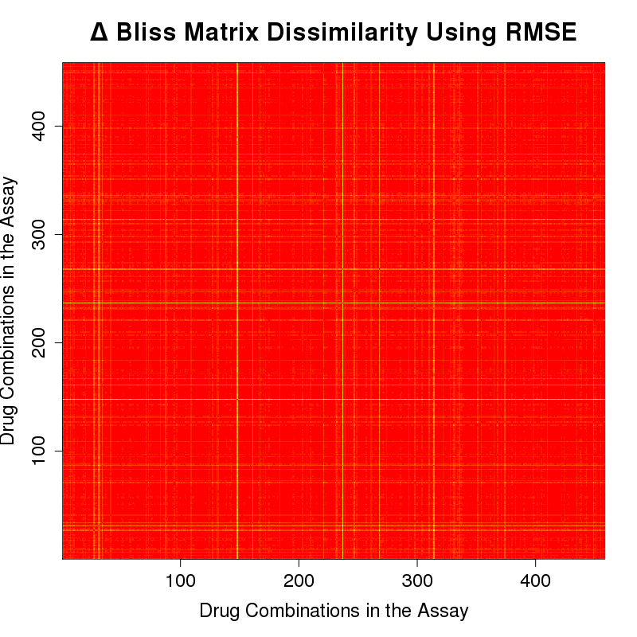
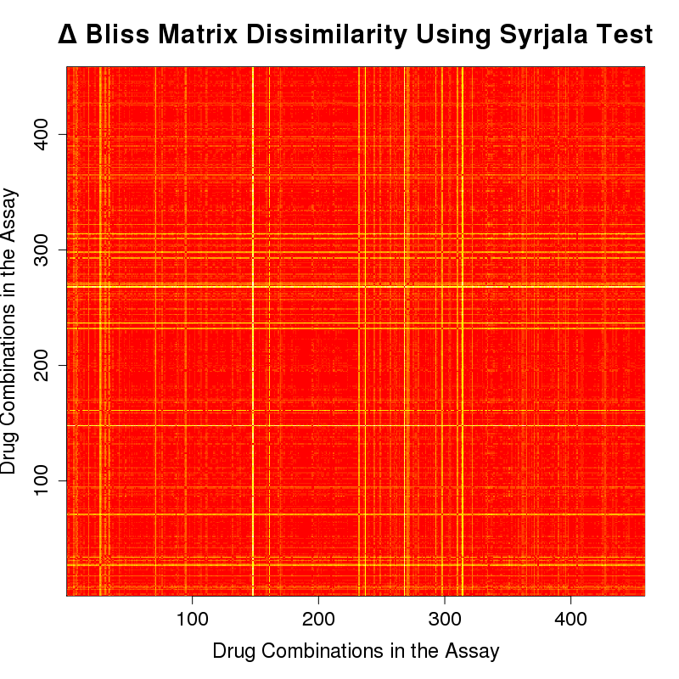
Question 1: Dissimilarity Metrics- Δ Bliss Matrices Malaria Strain HB3 (AID 1764)
Red: dissimilarity=0, more similar
Yellow: dissimilarity=1,
more dissimilar
RMSE
Syrjala Test

Slide 12
Overarching Questions
Question 1: What are metrics to quantify dissimilarity between two response matrices or synergy matrices?
Question 2: Does chemical structure correlate to combination response? Synergy? How?
Question 3: Does dose response correlate to combination response? Synergy? How?
Drug Combo A:
Response Matrix
Drug Combo B:
Response Matrix
Drug Combo A:
Compounds
Drug Combo B:
Compounds
Drug Combo A:
Dose Response
Drug Combo B:
Dose Response

Slide 13

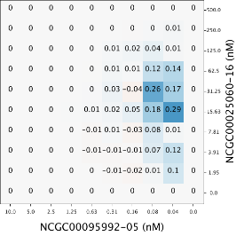
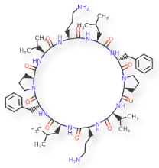
Question 2: Structure Correlated With Combination Response and Synergy
Is there a correlation between the dissimilarity of the compounds and the dissimilarity of the combination response surfaces? Δ Bliss (synergy) surfaces?

Slide 14
Question 2: Structure Correlated With Combination Response and Synergy- Dissimilarity of Compounds
Step 1. Compare one drug combination to another drug combination
Compare corresponding x agents
Compare corresponding y agents
Average those values
Step 2: Repeat for all pairs of combinations
x agents’ dissimilarity
y agents’ dissimilarity
Average dissimilarity

Slide 15
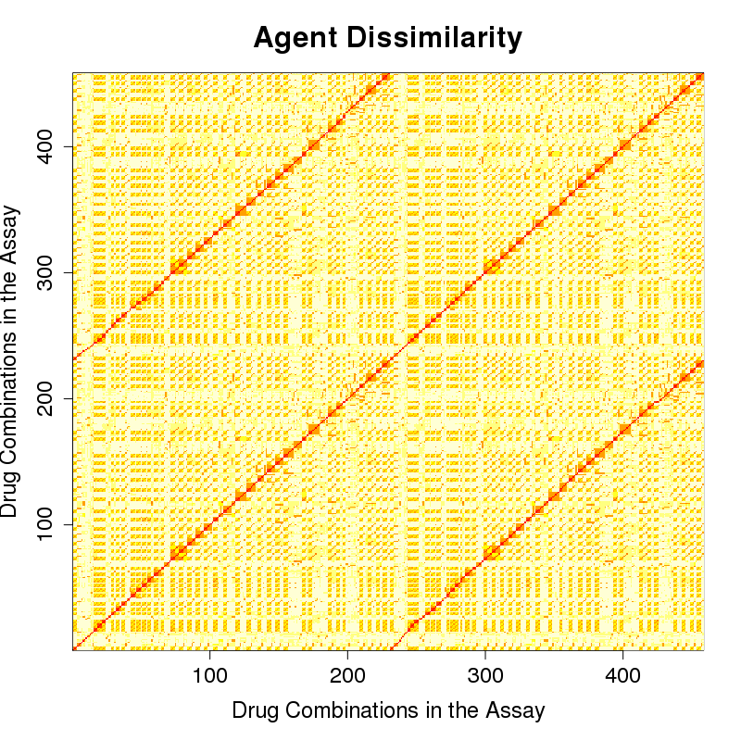
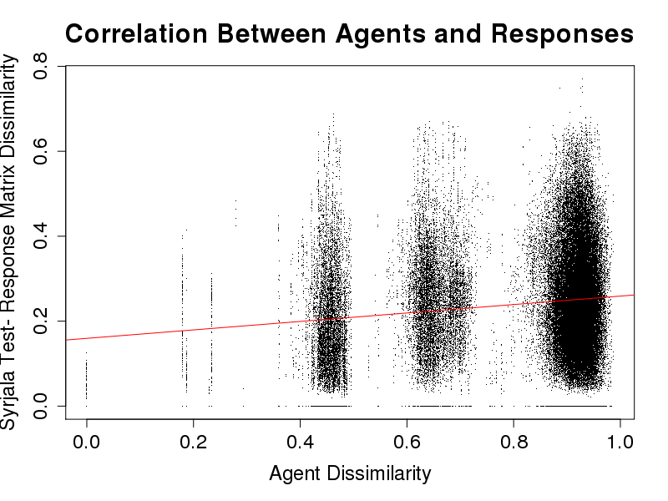
Question 2: Structure Correlated With Combination Response- Malaria Strain HB3 (AID 1764)
Agent Dissimilarities
Response Matrix Dissimilarities- Syrjala Test
R² = 0.0198
Red: dissimilarity=0, more similar
Yellow: dissimilarity=1, more dissimilar

Slide 16
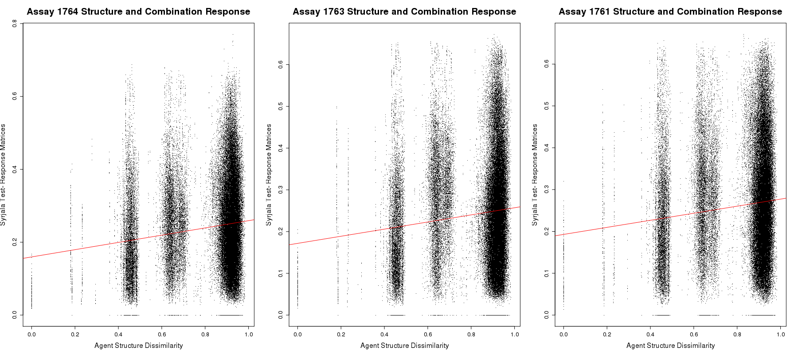
Question 2: Structure Correlated With Combination Response- Three Malaria Strains: HB3 (AID 1764), dD2 (AID 1763), 3D7 (AID 1764)

Slide 17
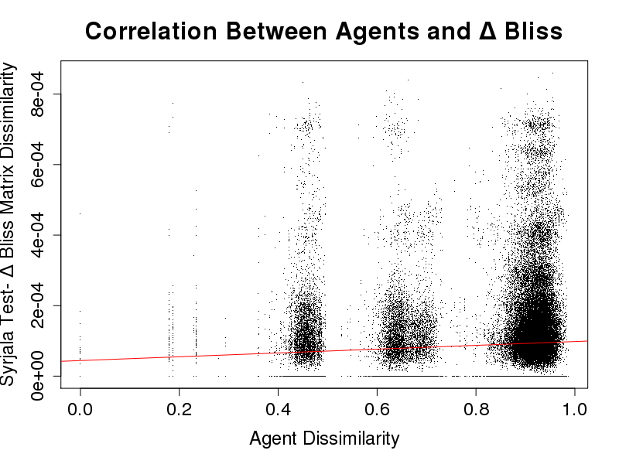
Question 2: Structure Correlated With Synergy- Malaria Strain HB3 (AID 1764)
Agent Dissimilarities
Δ Bliss (Synergy) Matrices- Syrjala Test
R² = 0.0056
Red: dissimilarity=0, more similar
Yellow: dissimilarity=1, more dissimilar

Slide 18
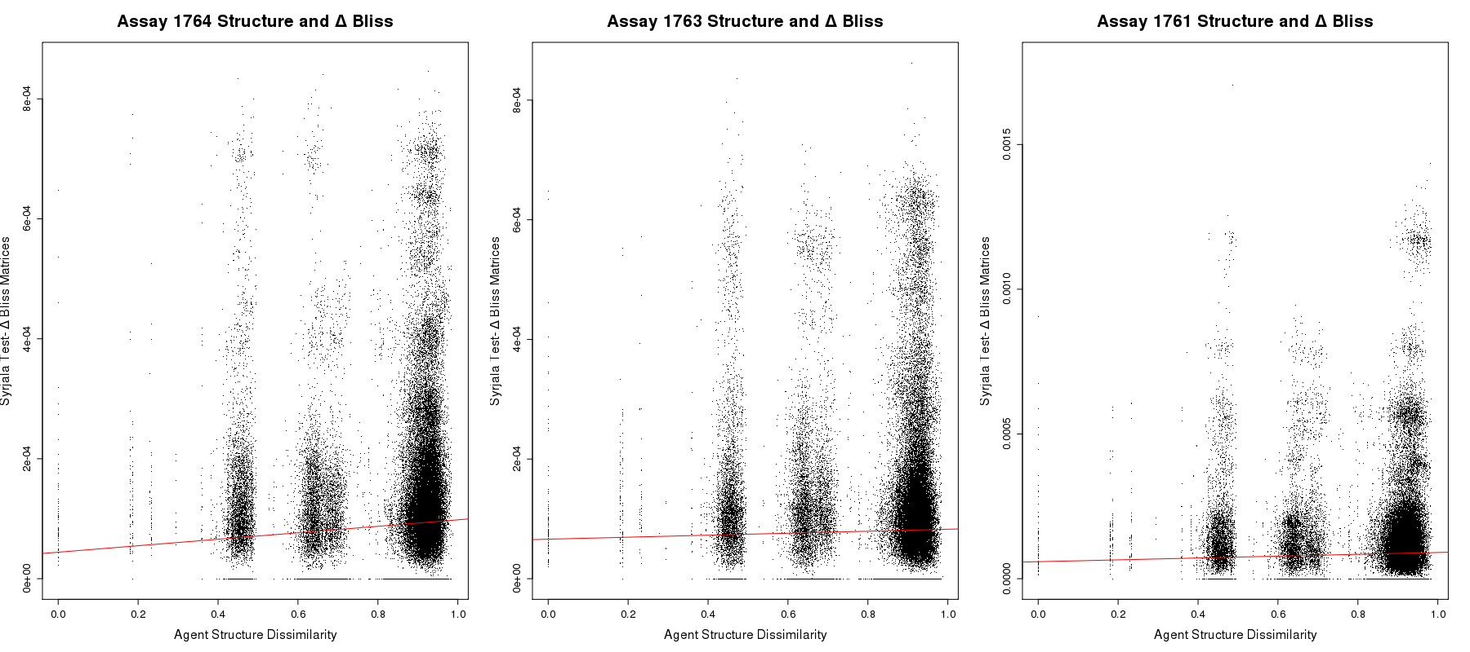
Question 2: Structure Correlated With Synergy- Three Malaria Strains: HB3 (AID 1764), dD2 (AID 1763), 3D7 (AID 1764)

Slide 19
Overarching Questions
Question 1: What are metrics to quantify dissimilarity between two response matrices or synergy matrices?
Question 2: Does chemical structure correlate to combination response? Synergy? How?
Question 3: Does dose response correlate to combination response? Synergy? How?
Drug Combo A:
Response Matrix
Drug Combo B:
Response Matrix
Drug Combo A:
Compounds
Drug Combo B:
Compounds
Drug Combo A:
Dose Response
Drug Combo B:
Dose Response

Slide 20
Question 3: Dose Response Correlated with Combination Response and Synergy
Is there a correlation between the dose responses of the compounds and the dissimilarity of the combination response surfaces? Δ Bliss (synergy) surfaces?

Slide 21
Question 3: Dose Response Correlated With Combination Response- Dissimilarity of Dose Responses
Step 1. Compare one dose response to another dose response using Lin’s CCC
Compare corresponding x agents
Compare corresponding y agents
Average those values
Step 2: Repeat for all combinations
x dose responses’ dissimilarity
y dose responses’ dissimilarity
Average dissimilarity
Lawrence I-Kuei Lin. (1989). A Concordance Correlation Coefficient to Evaluate Reproducibility. Biometrics, 45(1), 255-268.

Slide 22
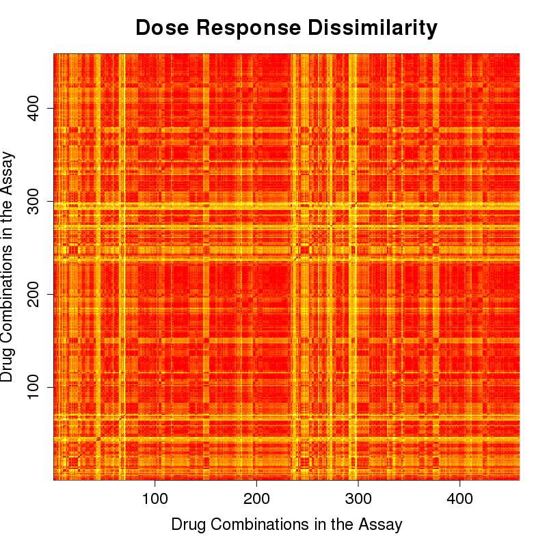
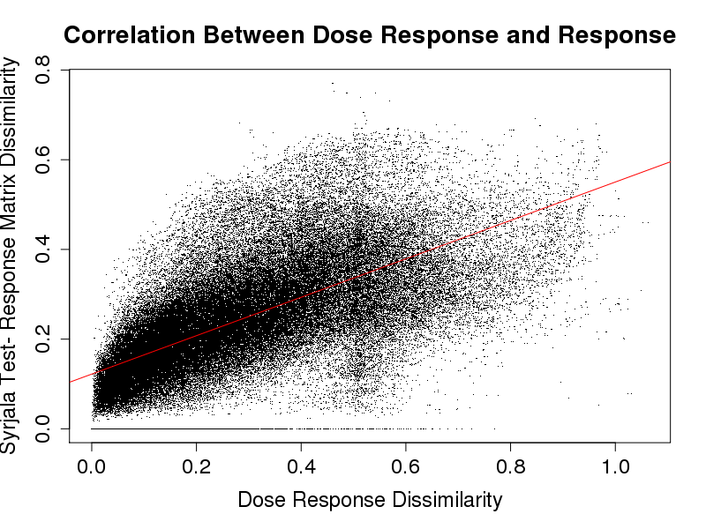
Question 3: Dose Response Correlated With Combination Response- Malaria Strain HB3 (AID 1764)
Dose Response Dissimilarities
Response Matrices- Syrjala Test
R² = 0.4365
Red: dissimilarity=0, more similar
Yellow: dissimilarity=1, more dissimilar

Slide 23
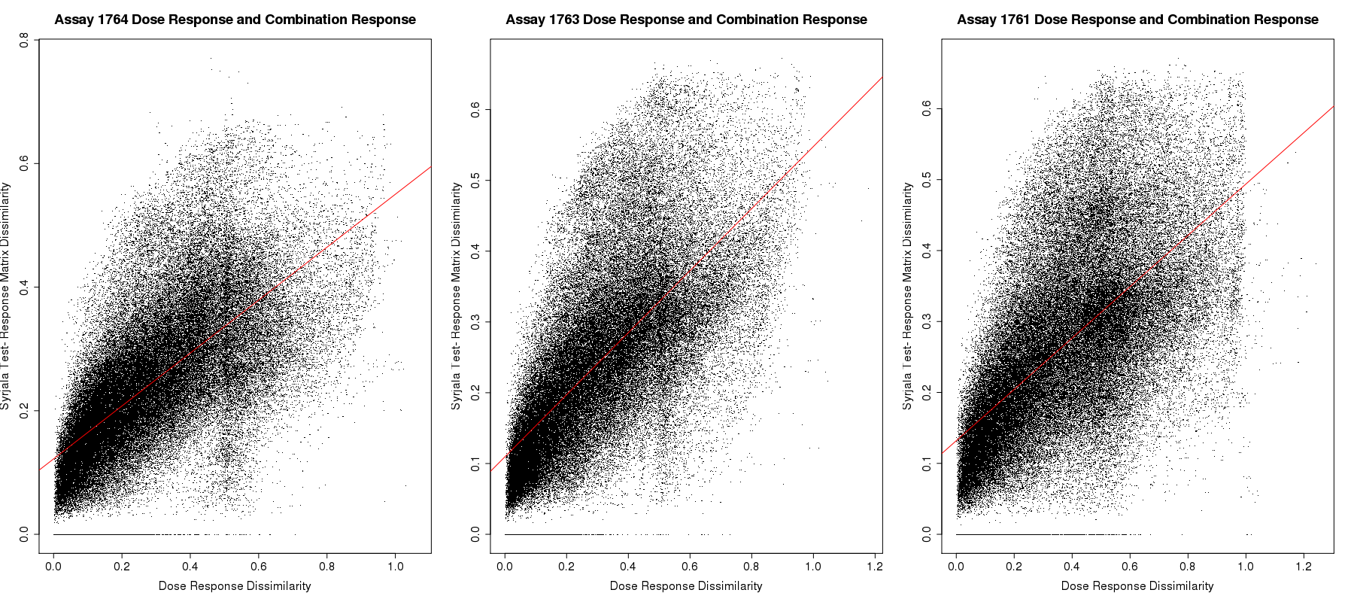
Question 3: Dose Response Correlated With Combination Response- Three Malaria Strains: HB3 (AID 1764), dD2 (AID 1763), 3D7 (AID 1764)

Slide 24
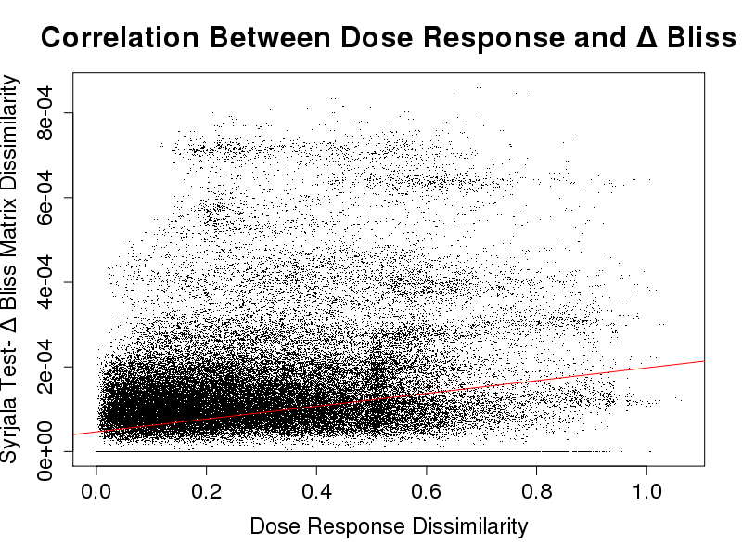
Question 3: Dose Response Correlated With Synergy- Malaria Strain HB3 (AID 1764)
Dose Response Dissimilarities
Δ Bliss (Synergy) Matrices- Syrjala Test
R² = 0.0521
Red: dissimilarity=0, more similar
Yellow: dissimilarity=1, more dissimilar

Slide 25
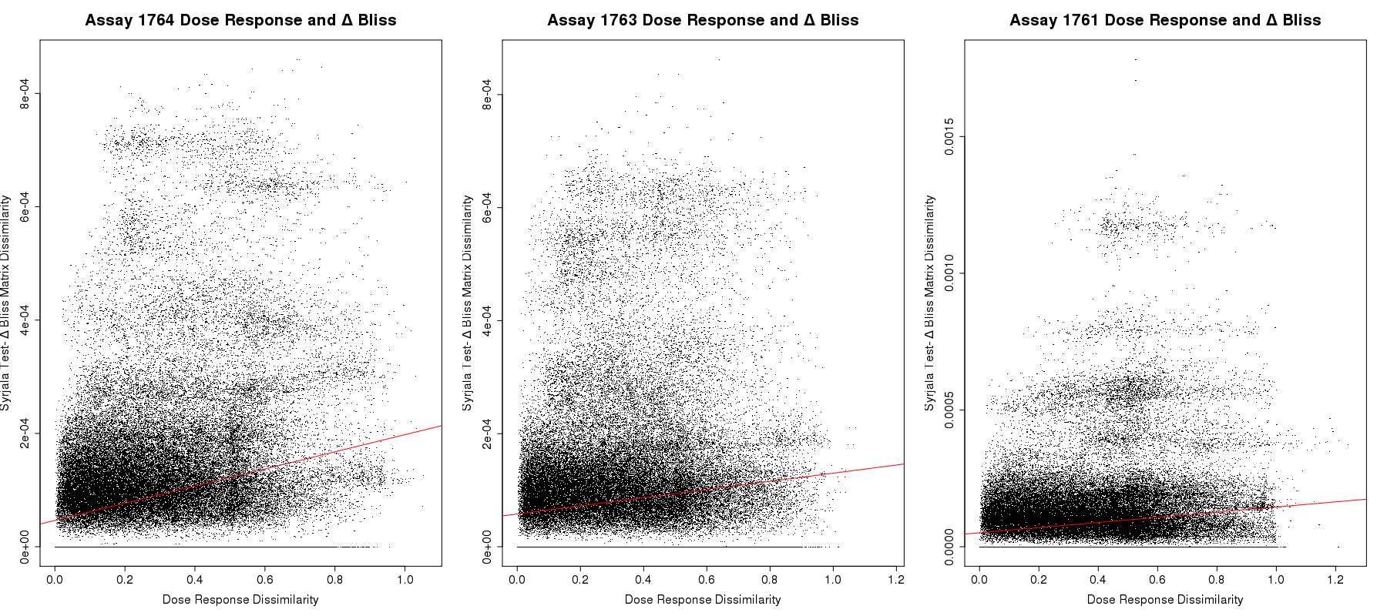
Question 3: Dose Response Correlated With Synergy- Three Malaria Strains: HB3 (AID 1764), dD2 (AID 1763), 3D7 (AID 1764)

Slide 26
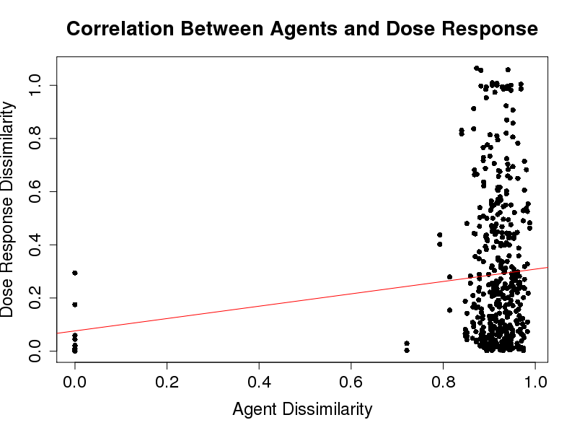
Conclusion
Individual Compounds:
We might expect structural similarity to correlate with dose response similarity- but they do not correlate
Suggests that using dose response as the compound property does not appear to be supported by the Similarity Property Principle (SPP)
No correlation (R² = 0.0141)
Drug Combinations:
For SPP to hold, both have to correlate- not the case
Δ Bliss plots show even weaker correlations than combination response
SPP does not appear to hold
Suggests that combination responses are not a simple function of the individual agent responses
No correlation (R² = 0.0198)
Correlation (R² = 0.4365)

Slide 27
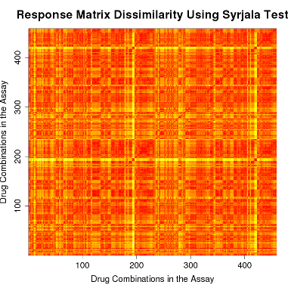
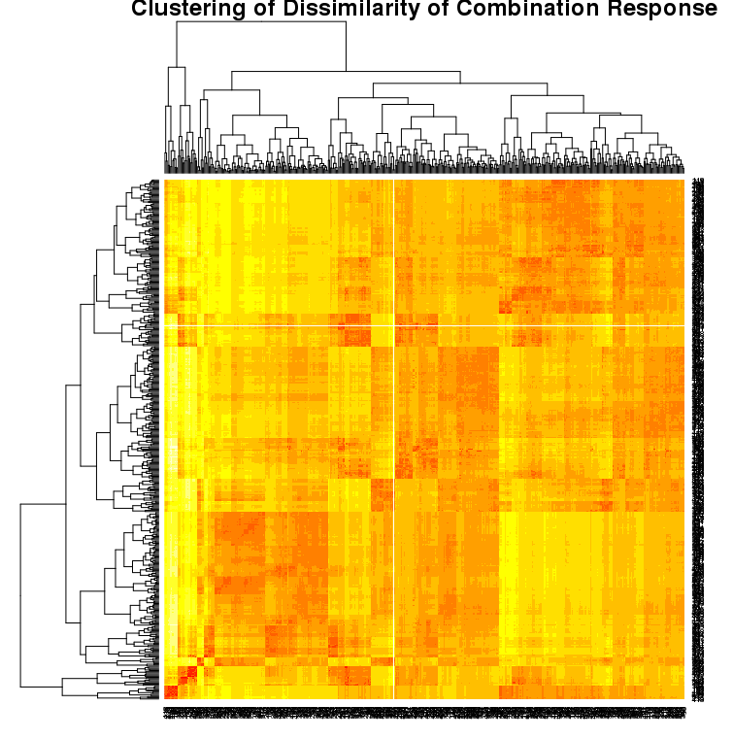
Discussion
Limitations
Dose response was not a compound property that illustrated the SPP well- use one that does
Will be able to draw better conclusions about the SPP for drug combinations using a
different compound property that is
supported by the SPP
Future Work
Clustering- work within clusters
Analysis on larger, more diverse volume of data
No correlation (R² = 0.01414)

